Slide 1

ADW Enhanced Generative
Integrated Scheduler
Member Guide

Slide 2
Table of Content
Requests module
Create new requests / View submitted requests
Edit/Delete requests
Schedules module
Viewing published schedules

Slide 3
Requests module
Create new requests / View submitted requests

Slide 4
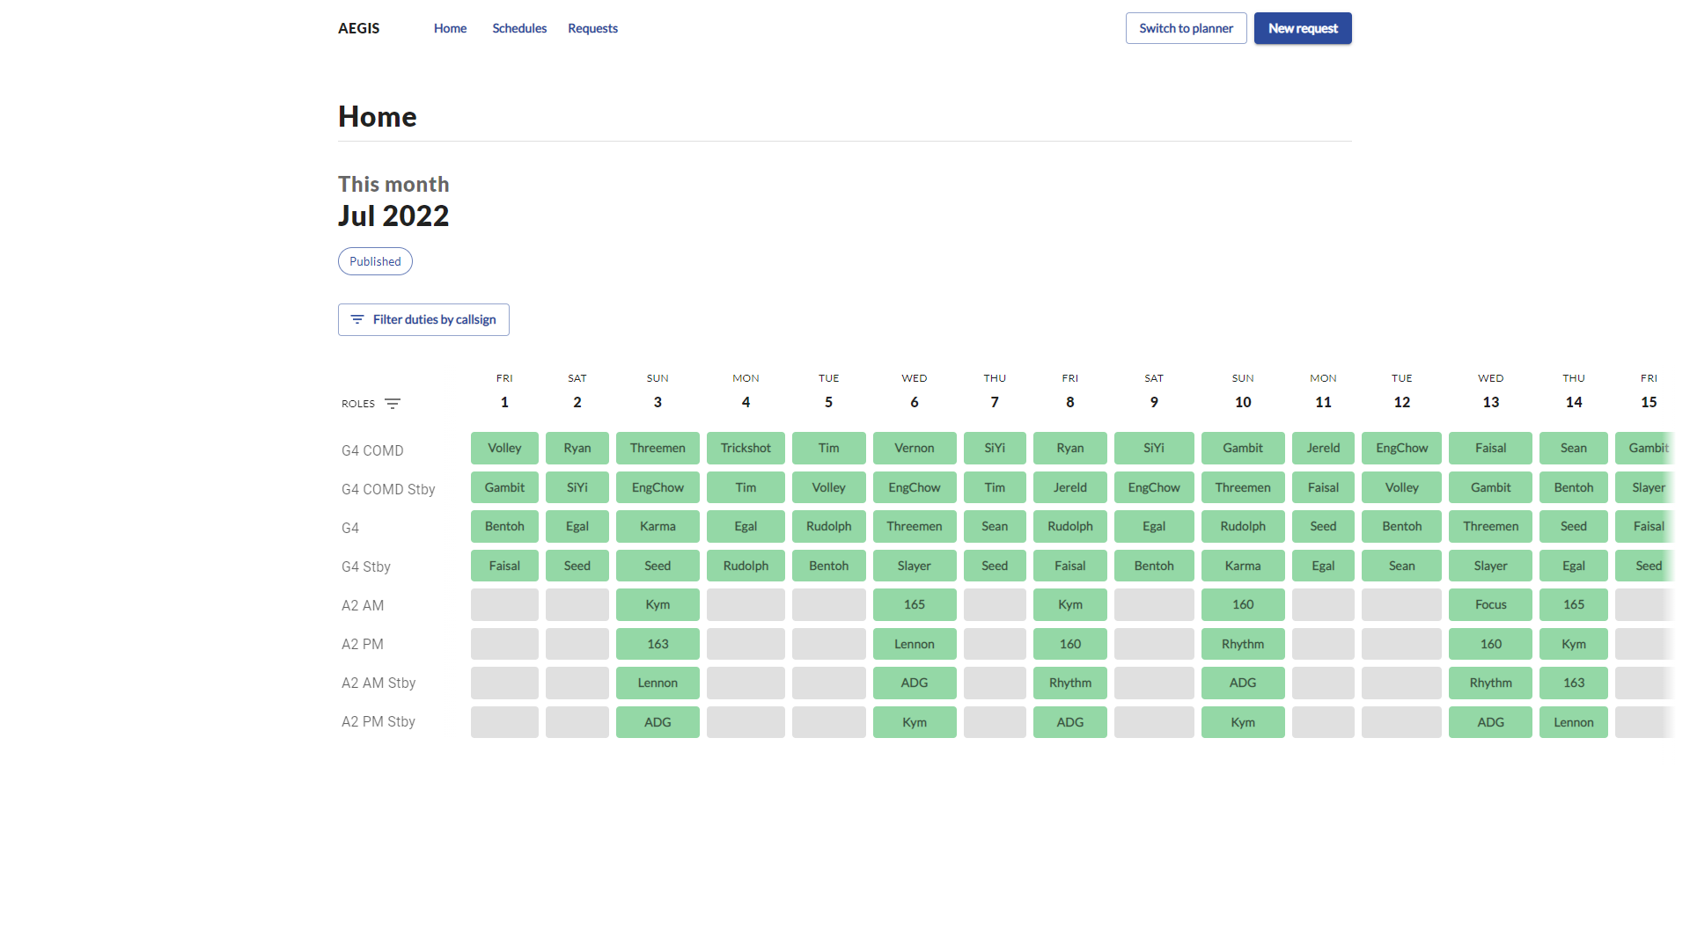
Click to access requests
The default home page is the published schedule of the current month (if applicable)

Slide 5
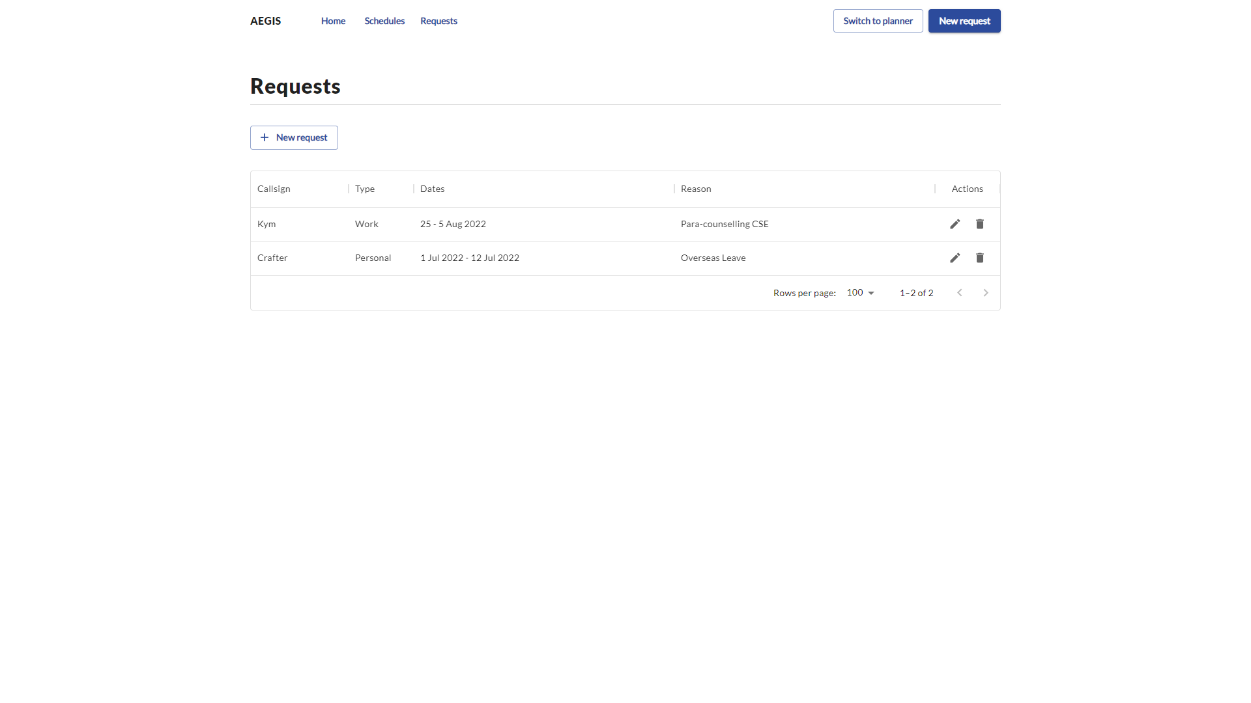
Click to create new requests

Slide 6
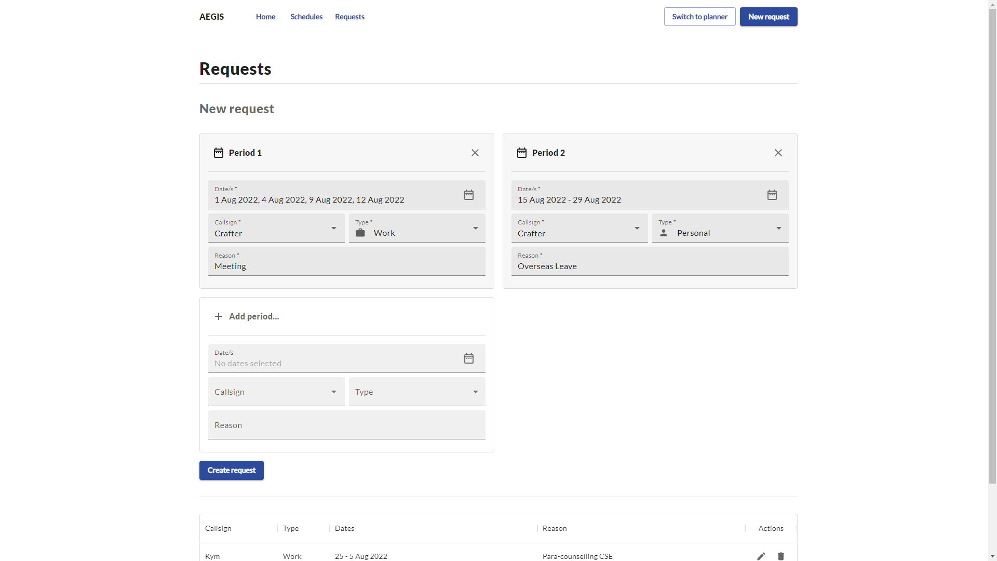
Click to create requests
Create multiple requests

Slide 7
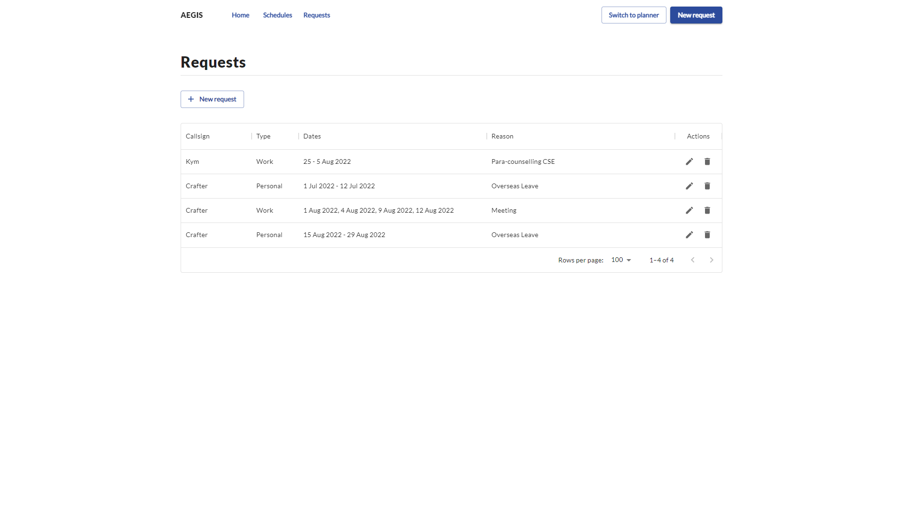
Requests are automatically updated upon creation

Slide 8
Requests module
Edit/Delete requests

Slide 9
Edit request
Delete request

Slide 10
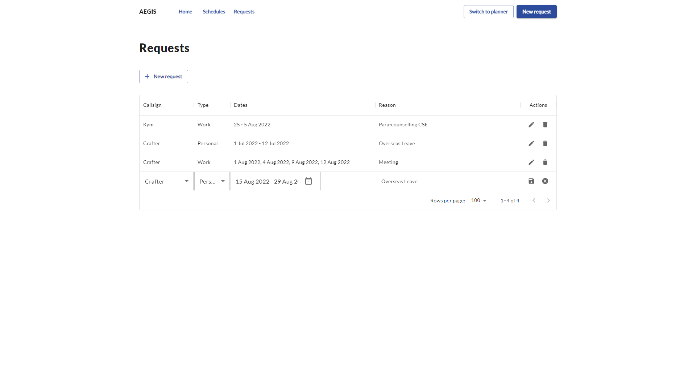
Cancel edits
Callsign, Type, Dates, Reasons are editable
Click to save edits

Slide 11
Schedules module
Viewing published schedules

Slide 12
Click to access all published schedules

Slide 13
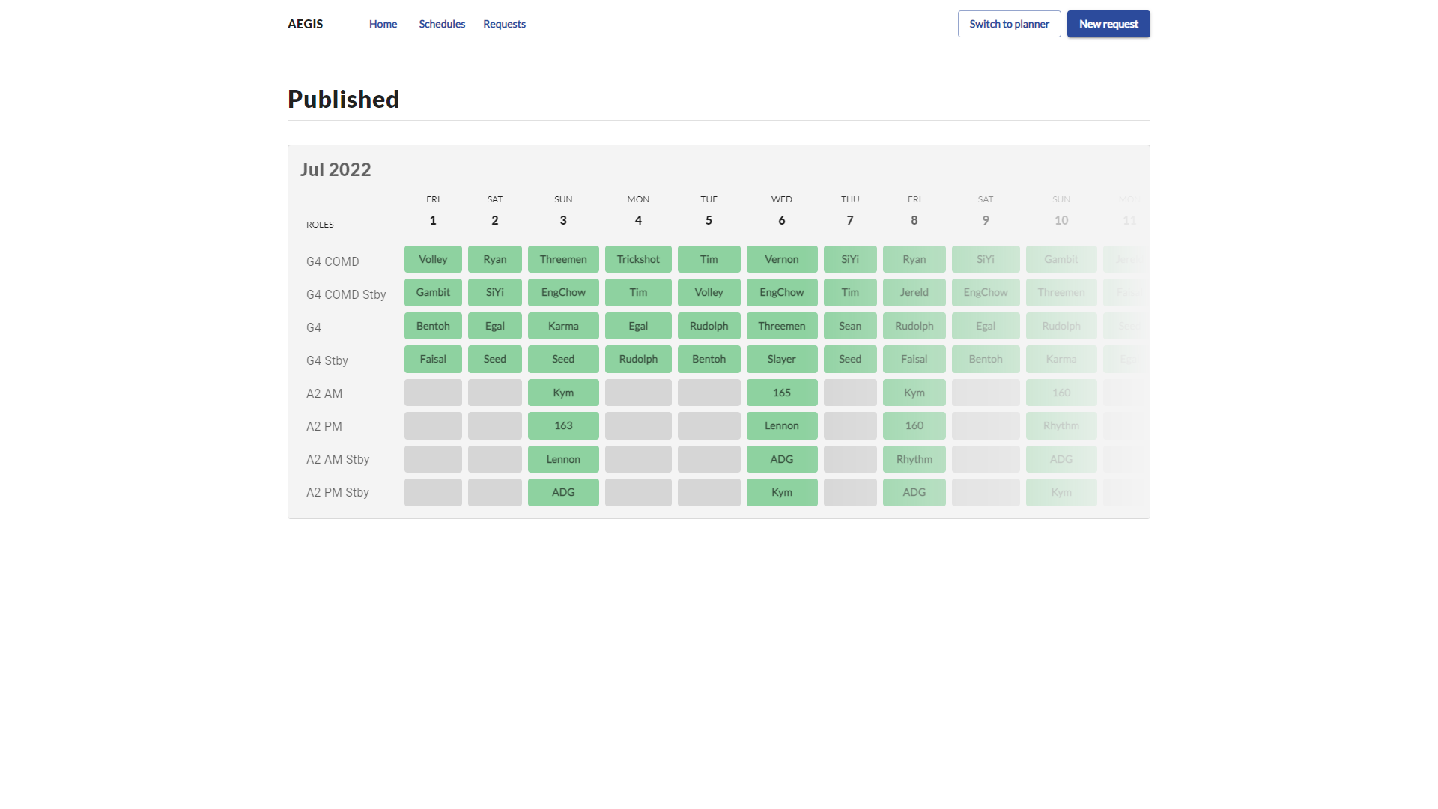
All published schedules by the planner (past & present) can be found on this tab

